Slide 1
Open-Detective: 基于 SQLBot 与 OpenDigger 的开源社区全维风险智能审计系统
--Don't just query. Investigate.
队伍：mmking
成员：李雨峰

Slide 2
目录
01
背景意义
02
项目概述
03
技术框架及重难点

Slide 3
背景意义
01

Slide 4
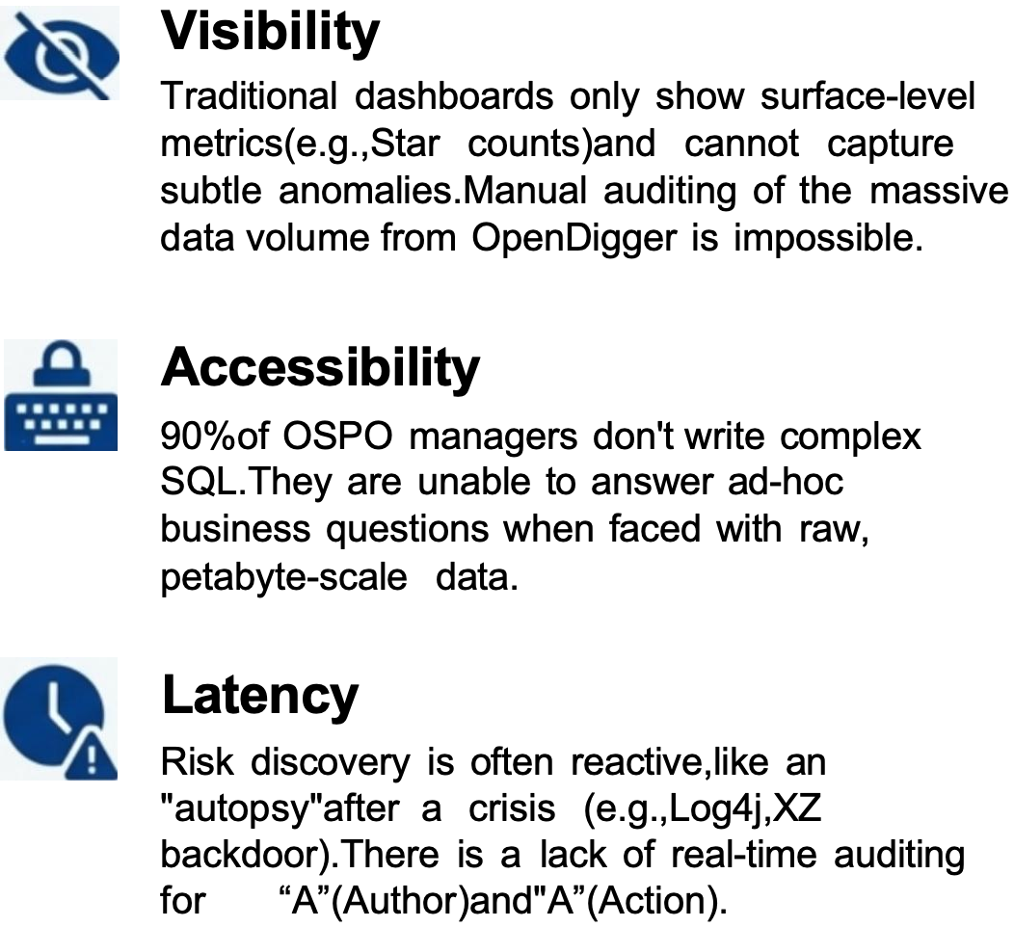
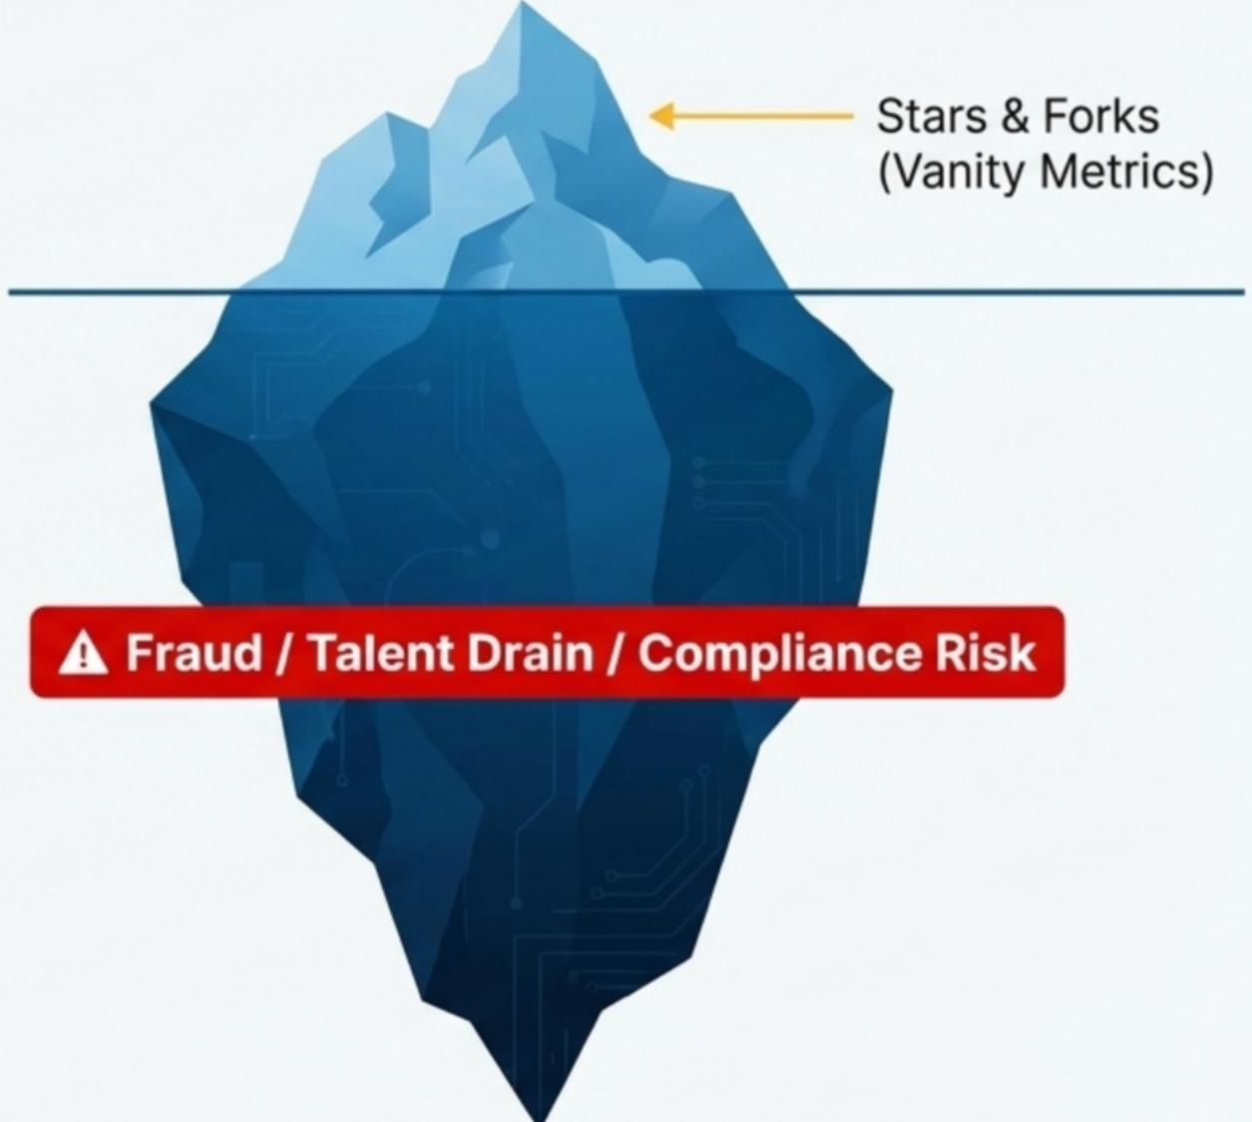
Open-Detective: 开源社区全维风险智能审计系统

Slide 5
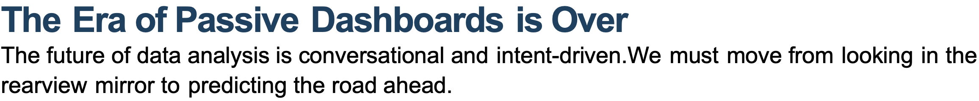
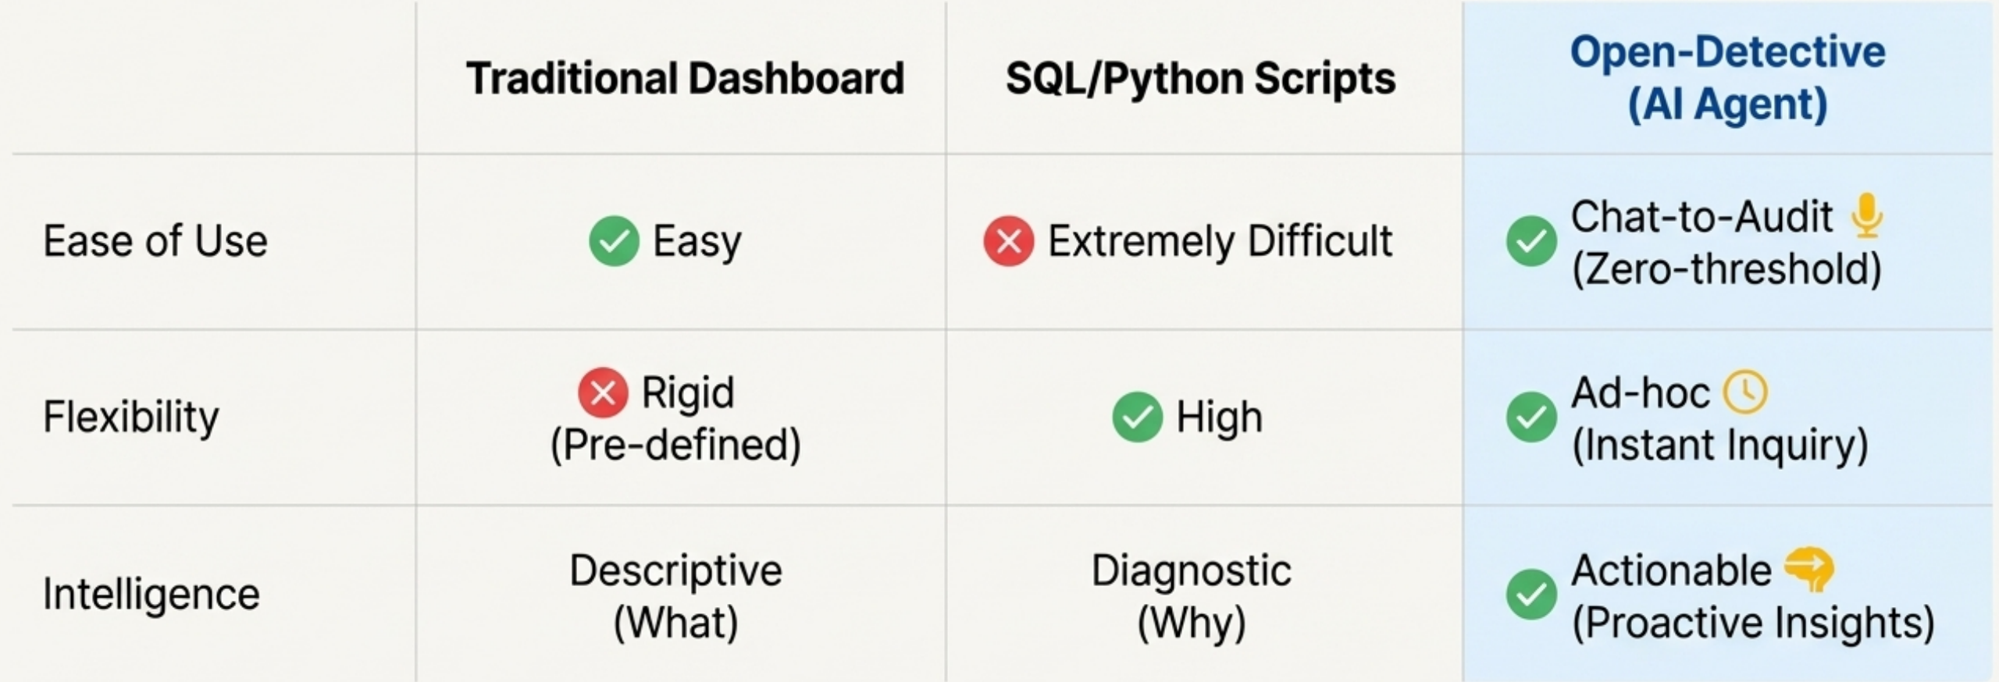
Open-Detective: 开源社区全维风险智能审计系统

Slide 6
项目概述
02

Slide 7

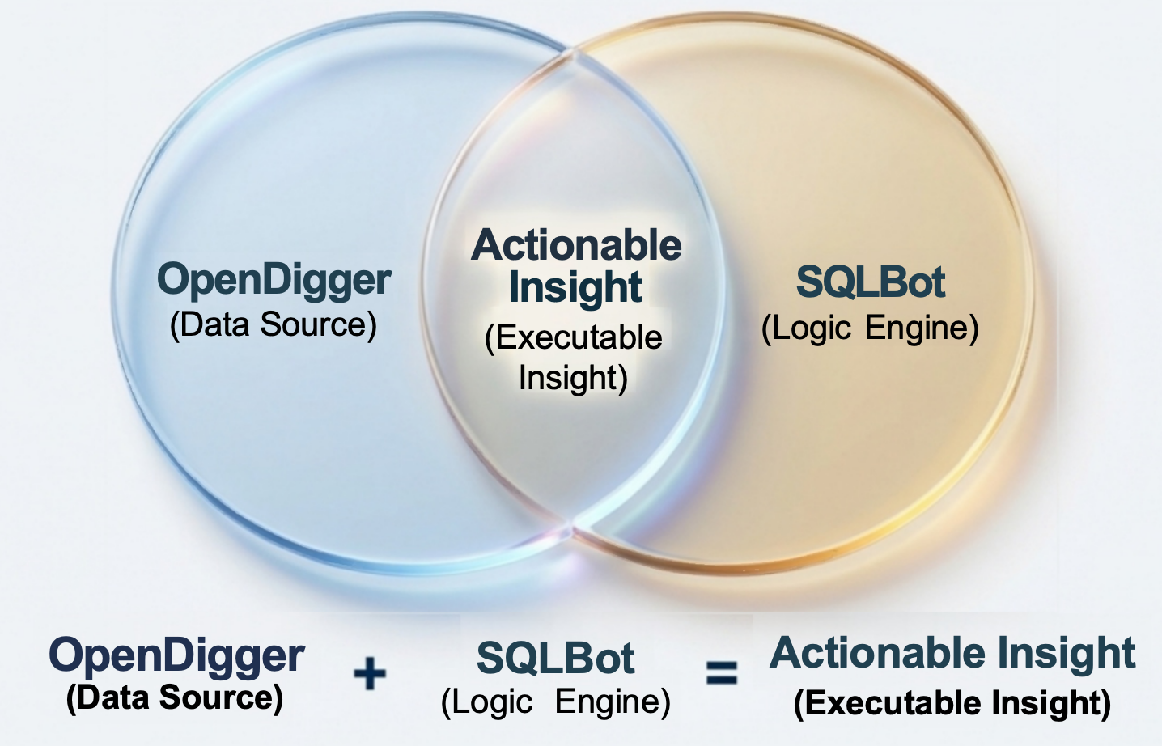
Open-Detective: 开源社区全维风险智能审计系统
How it Works:
Open-Detective is an interactive Al Agent based on Text-to-SQL technology.It empowers
non-technical managers to
conduct complex investigations, support multi-turn dialogue,
detect anomalies,and
generate visualizations using simple natural language.

Slide 8
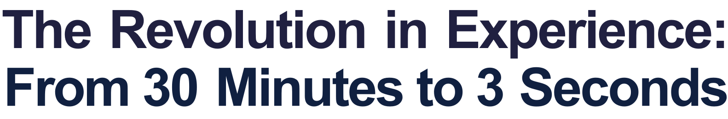
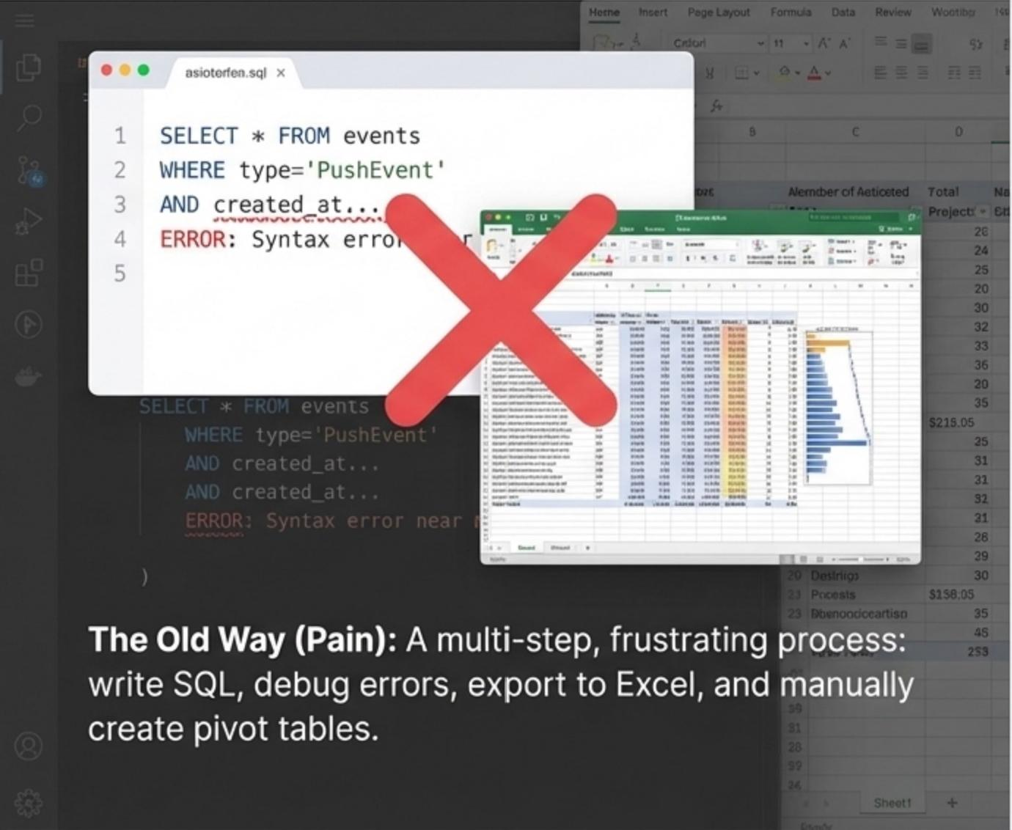
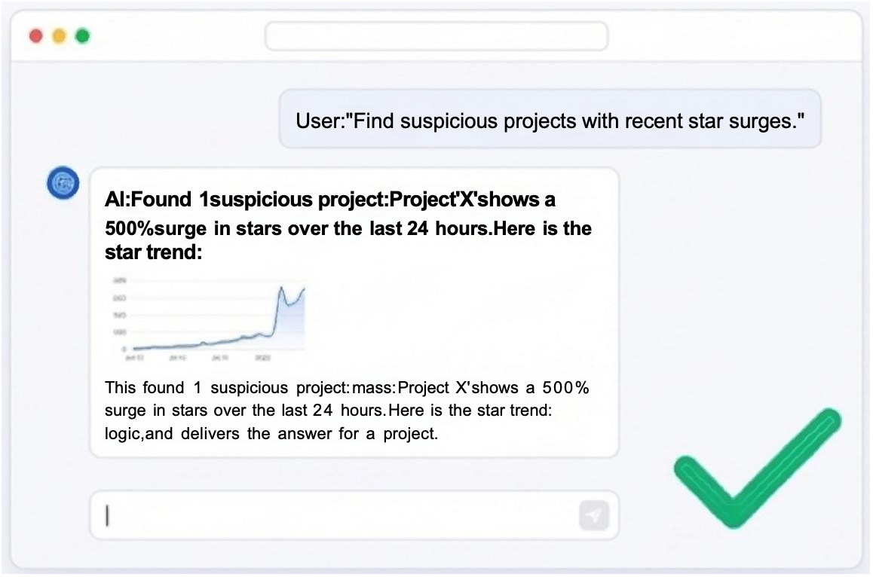
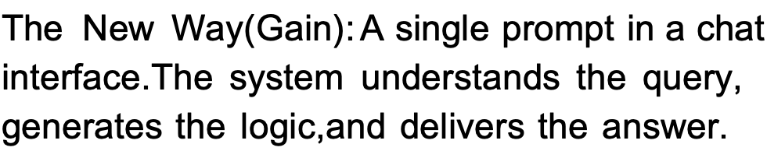
Open-Detective: 开源社区全维风险智能审计系统

Slide 9
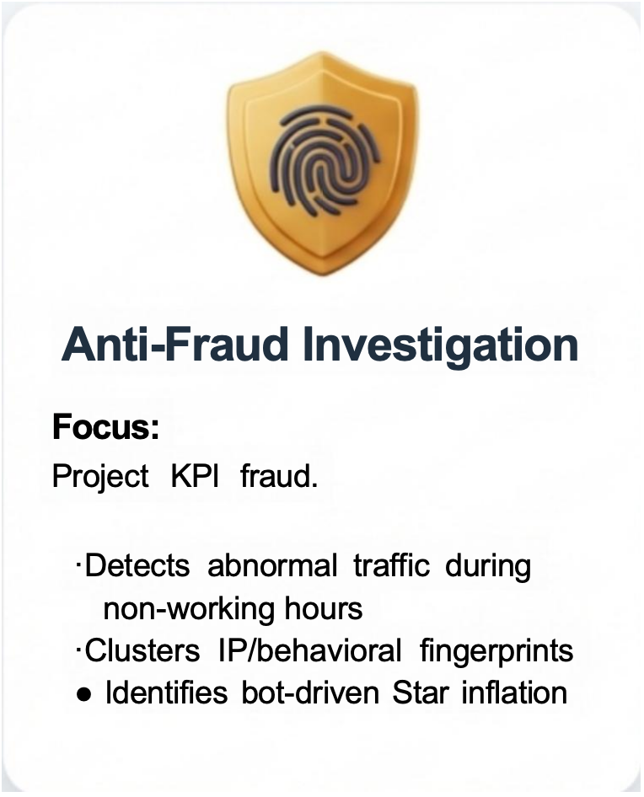
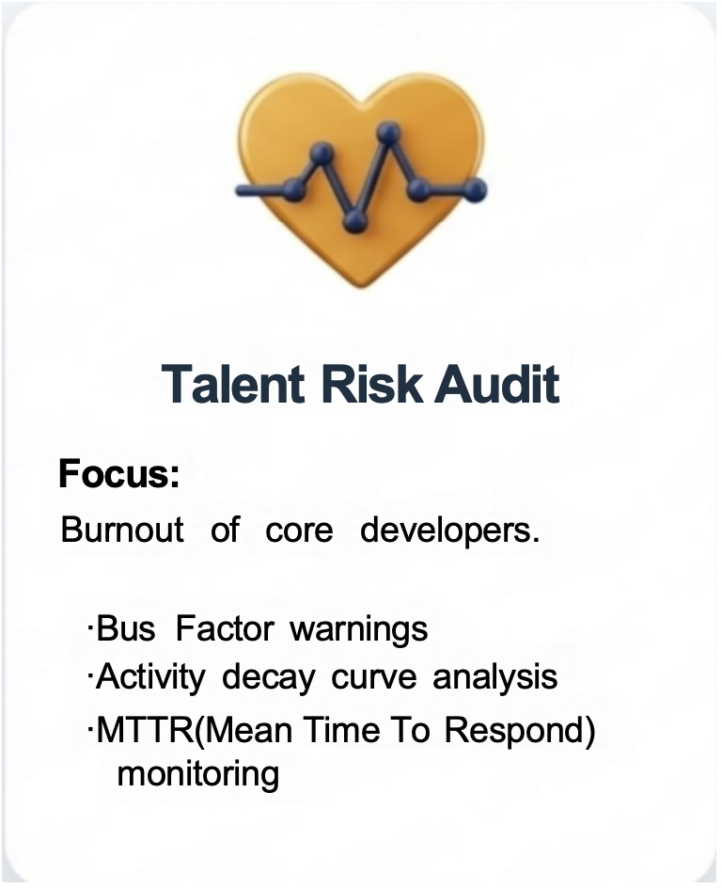
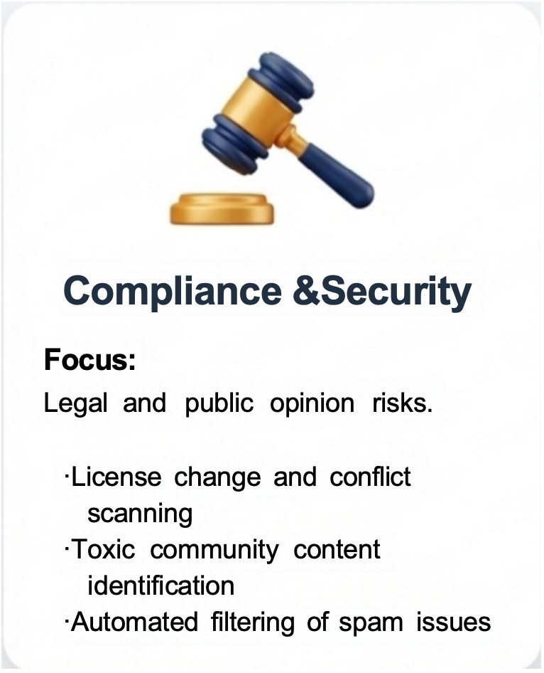
Open-Detective: 开源社区全维风险智能审计系统
Three Core Case Files Covering the Full
Lifecycle of Open Source Governance

Slide 10
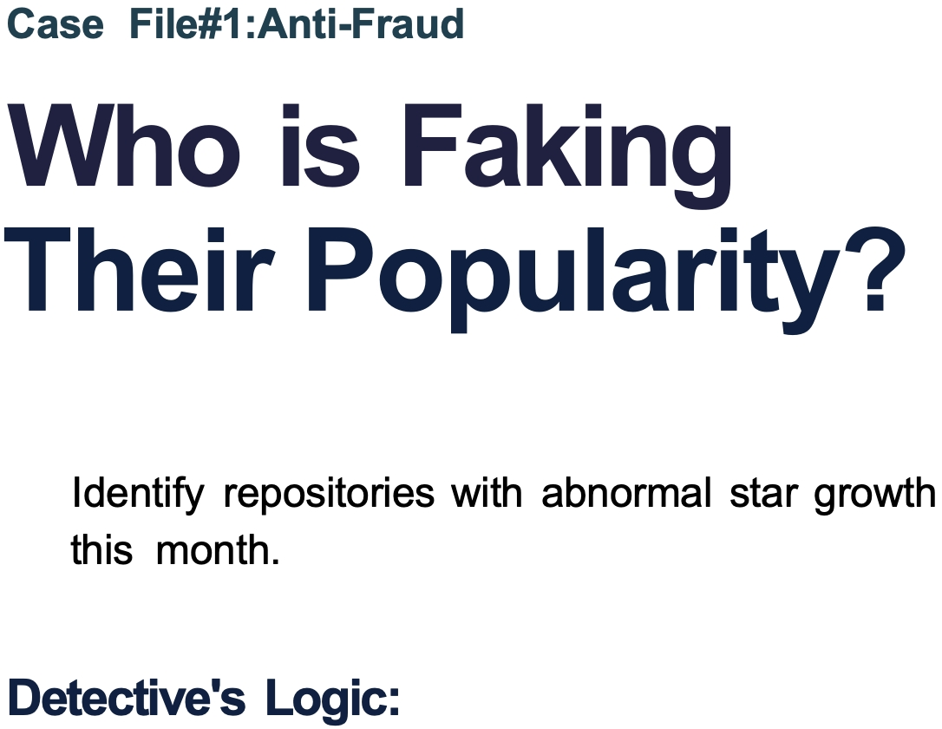
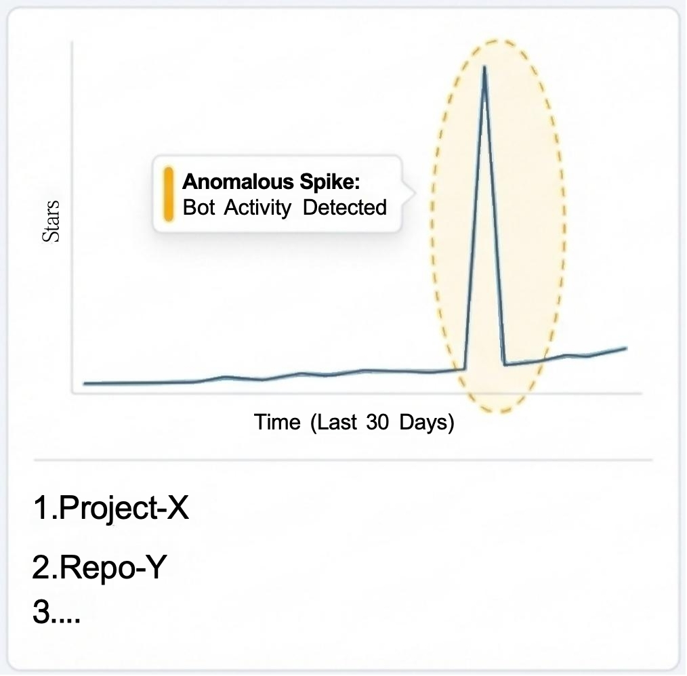
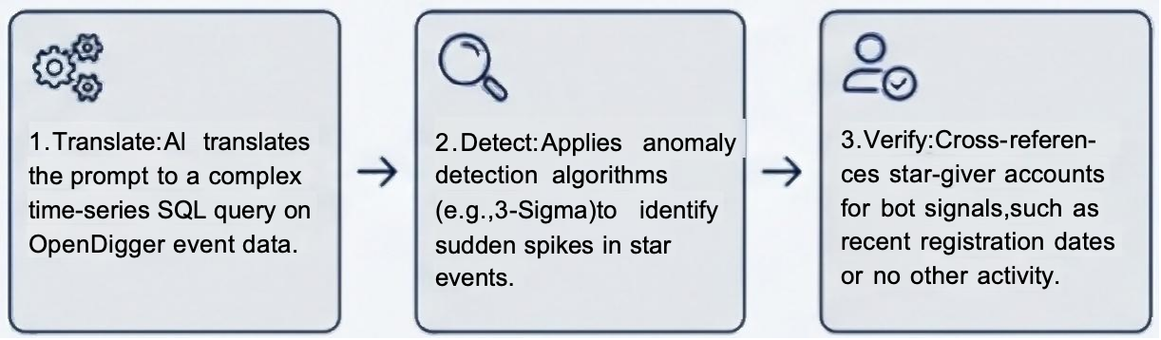
Open-Detective: 开源社区全维风险智能审计系统

Slide 11
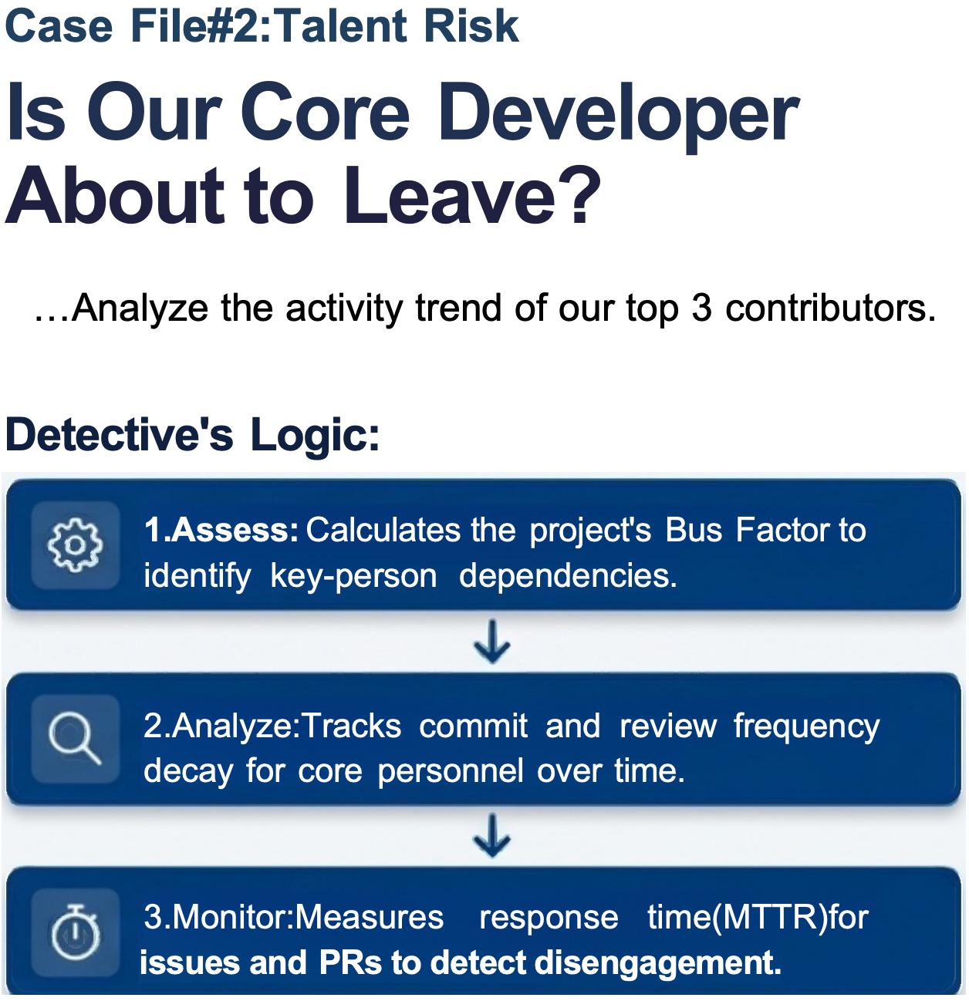
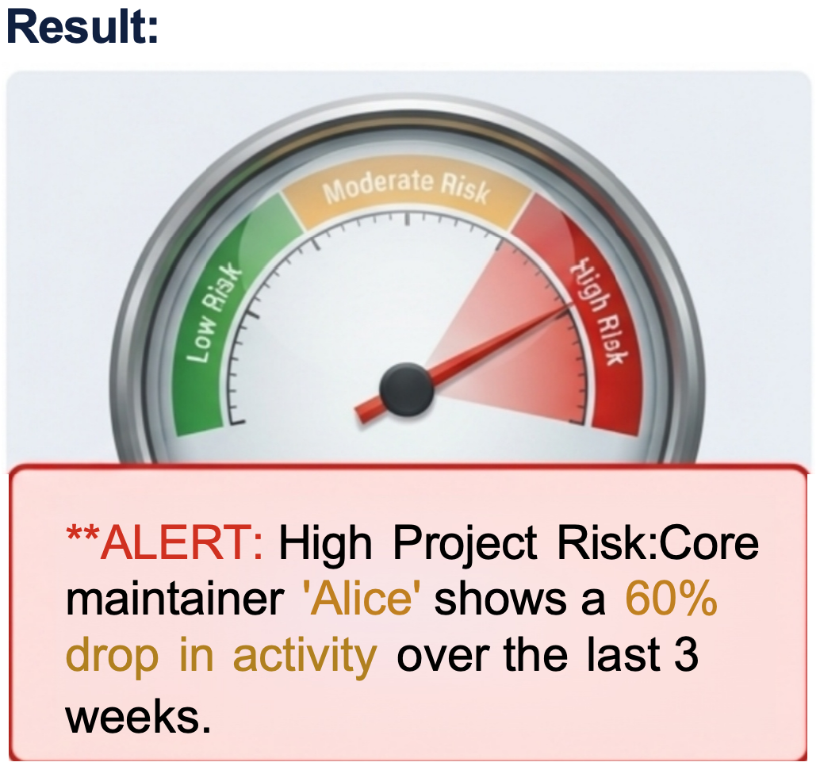

Open-Detective: 开源社区全维风险智能审计系统

Slide 12
技术框架及重难点
03

Slide 13
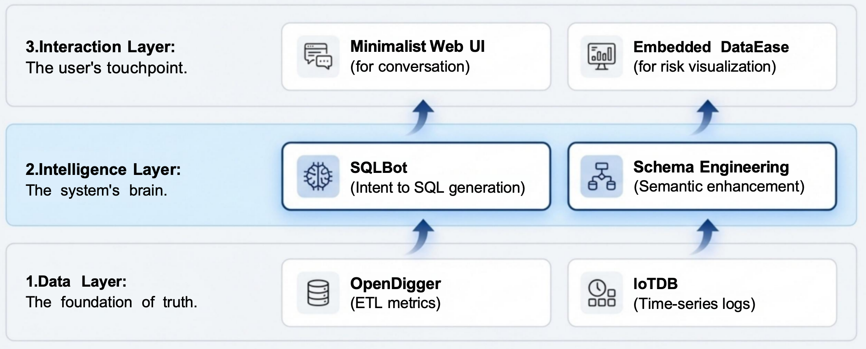
Open-Detective: 开源社区全维风险智能审计系统
A Three-Layer Intelligence Architecture

Slide 14
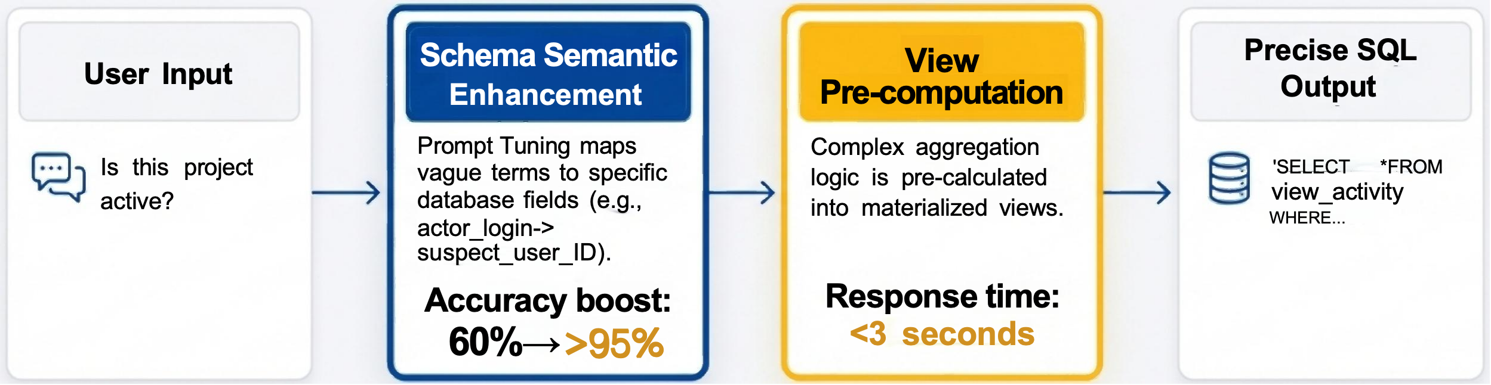
Open-Detective: 开源社区全维风险智能审计系统
How We Make the AI Detective Both Accurate and Fast
Breakthrough 1:Solving Hallucination
We perform Prompt Tuning on over 50+
complex OpenDigger fields to make the Al truly understand business terminology.
Breakthrough 2:Solving Slow Queries
We encapsulate complex query logic into
database Views,simplifying the AI's reasoning path for second-level response times.

Slide 15
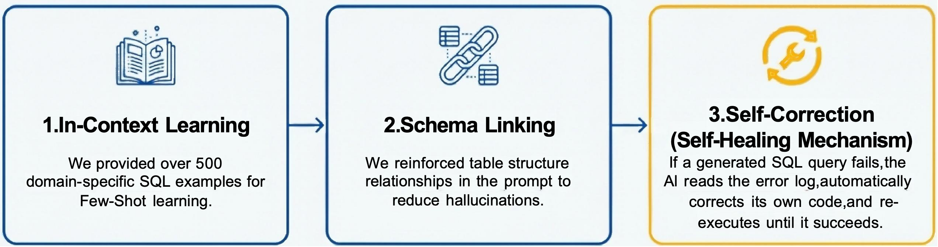
Open-Detective: 开源社区全维风险智能审计系统
The Secret Weapon:Why Our SQLBot Is Smarter
The Problem: General-purpose LLMs have a raw SQL generation accuracy of only ~30%,which is unusable in production.
Our Solution: A Three-Pronged Optimization
The Result: Final execution success rate is over 95%.

Slide 16
技术创新
04

Slide 17
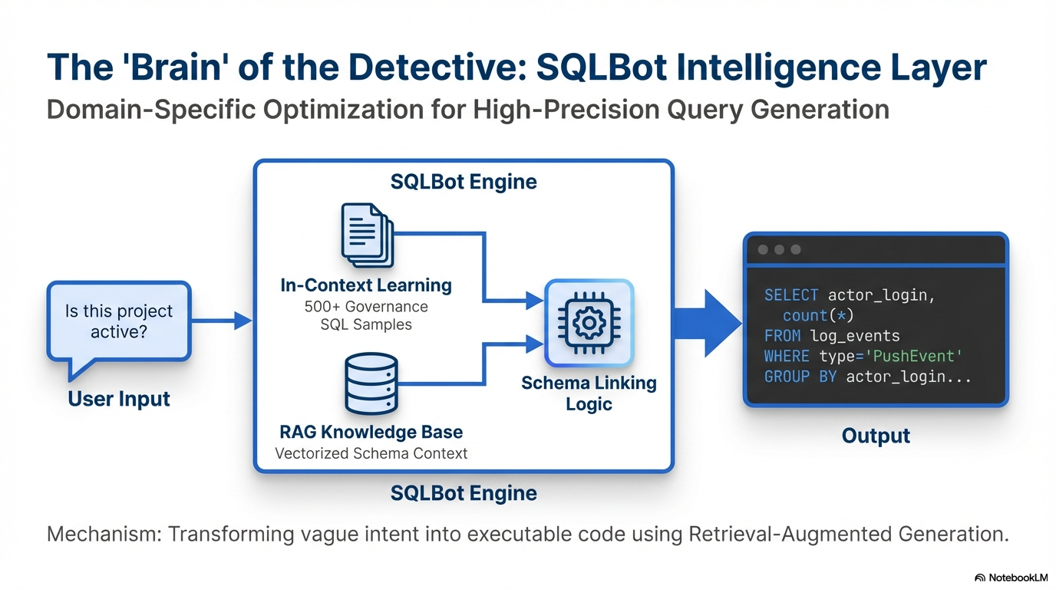
Open-Detective: 开源社区全维风险智能审计系统

Slide 18
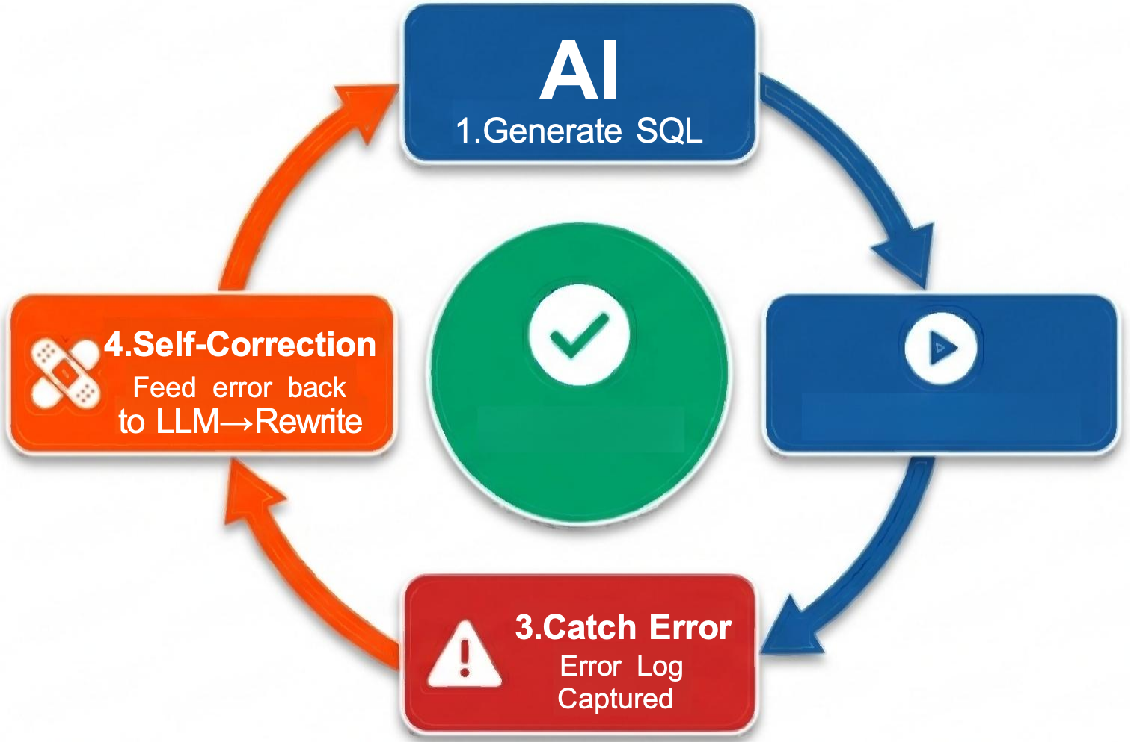
Open-Detective: 开源社区全维风险智能审计系统
The Self-Healing Loop:Achieving 95%+Execution Success
Automated debugging transforms 30%baseline accuracy into production-grade reliability.
95%
Execution Success Rate
Vs 30%General LLM Baseline
The system reads database error logs to diagnose syntax
faults and regenerates the query automatically.

Slide 19
深度分析
05

Slide 20
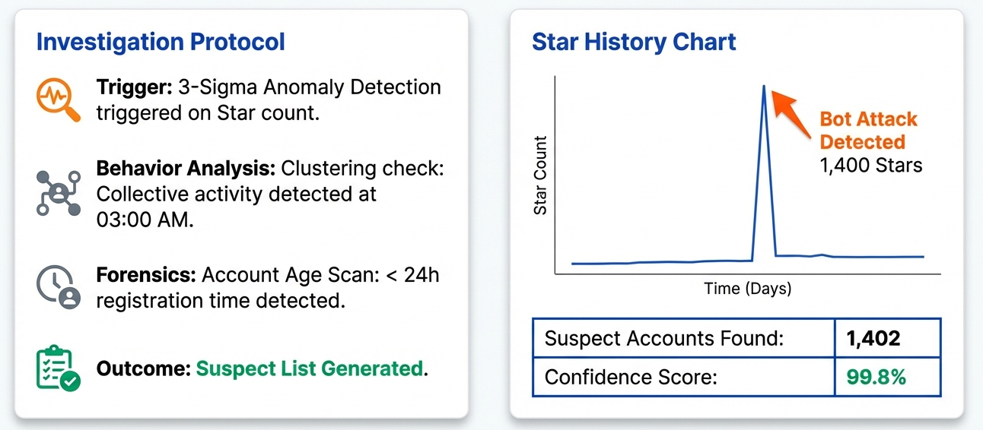
Open-Detective: 开源社区全维风险智能审计系统
Case File 1:Anti-Fraud Investigation
Automated Anomaly Detection:"Who is faking the stars?"

Slide 21
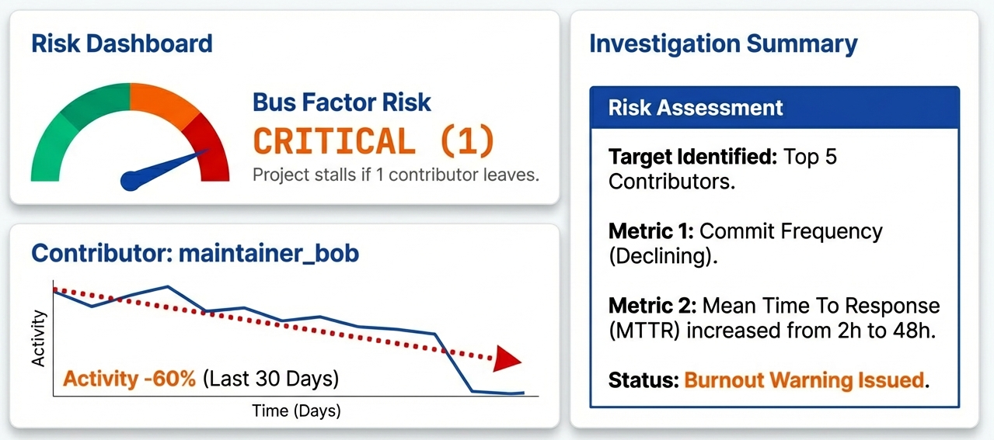
Open-Detective: 开源社区全维风险智能审计系统
Case File 2:Talent Risk &The 'Bus Factor'
Predicting burnout and key developer loss before it happens.

Slide 22
技术实现
06

Slide 23
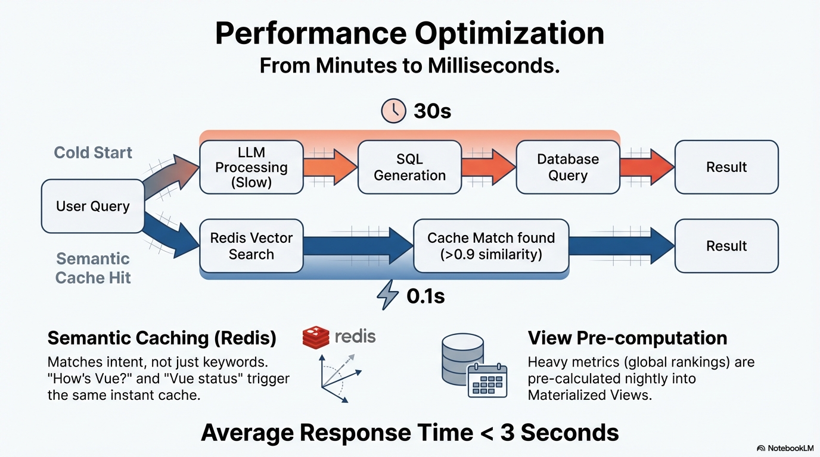
Open-Detective: 开源社区全维风险智能审计系统

Slide 24
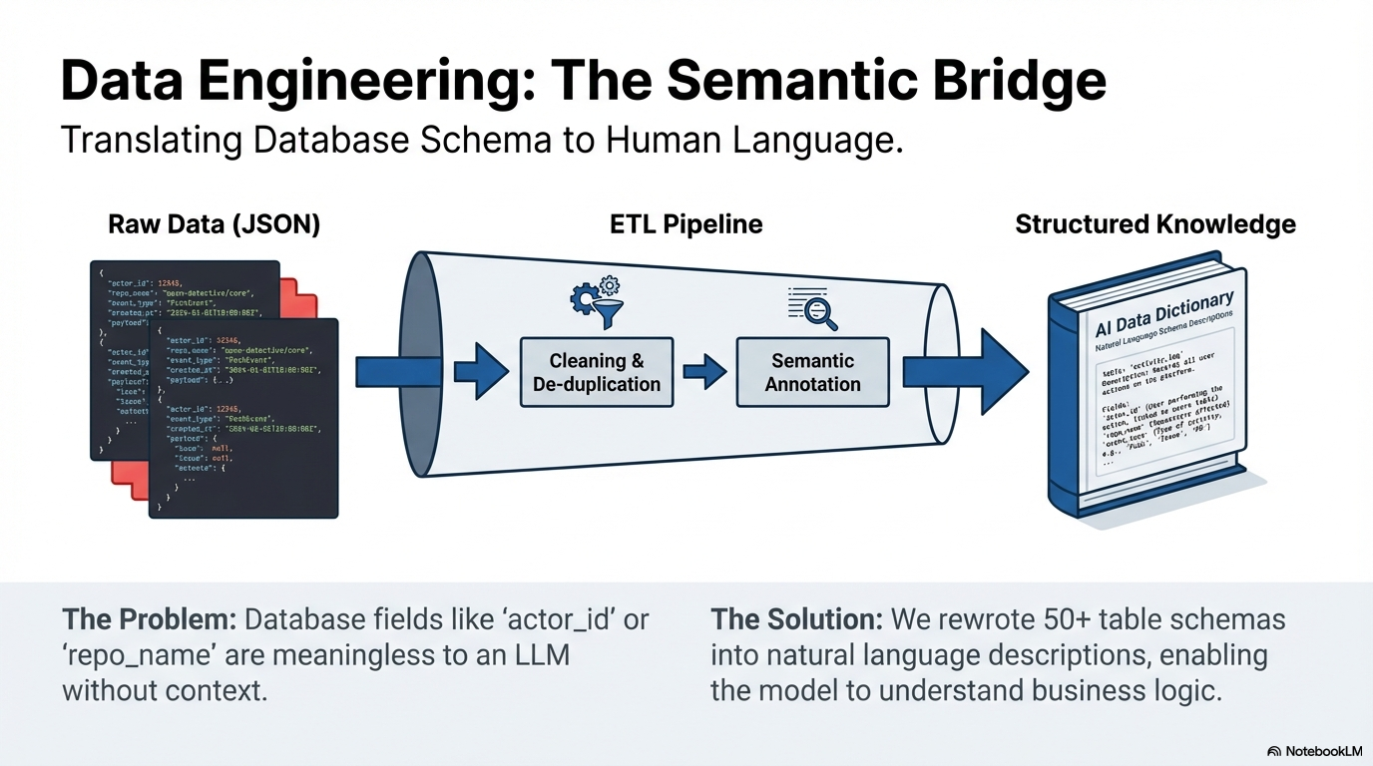
Open-Detective: 开源社区全维风险智能审计系统

Slide 25
功能截图
06

Slide 26
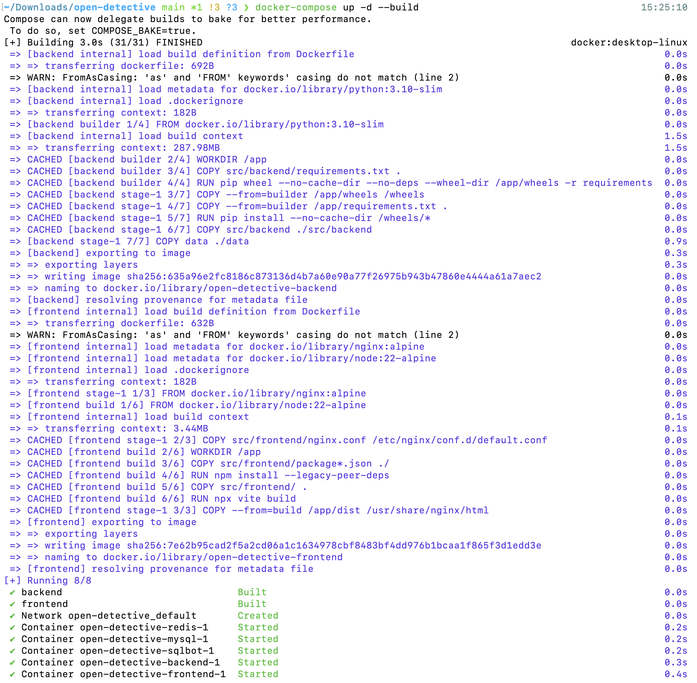
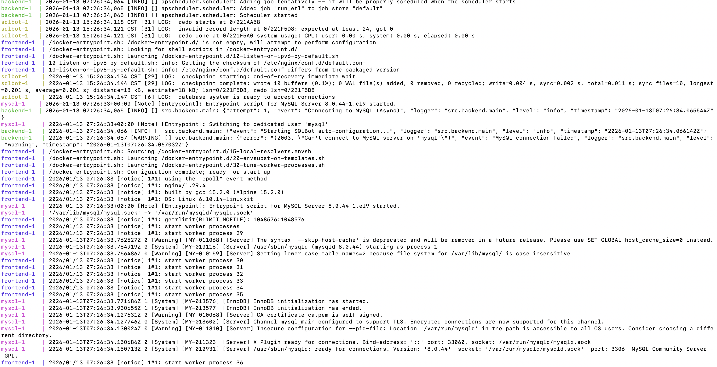
Open-Detective: 开源社区全维风险智能审计系统
全栈容器化:
Docker Compose 一键部署
完善的日志信息

Slide 27
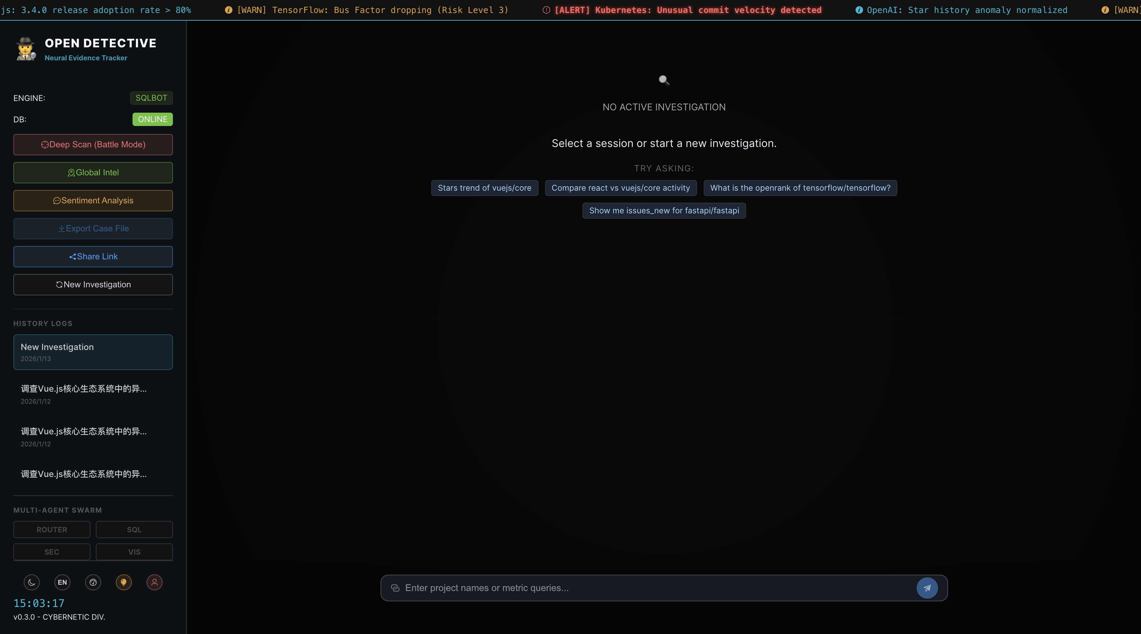
Open-Detective: 开源社区全维风险智能审计系统

Slide 28
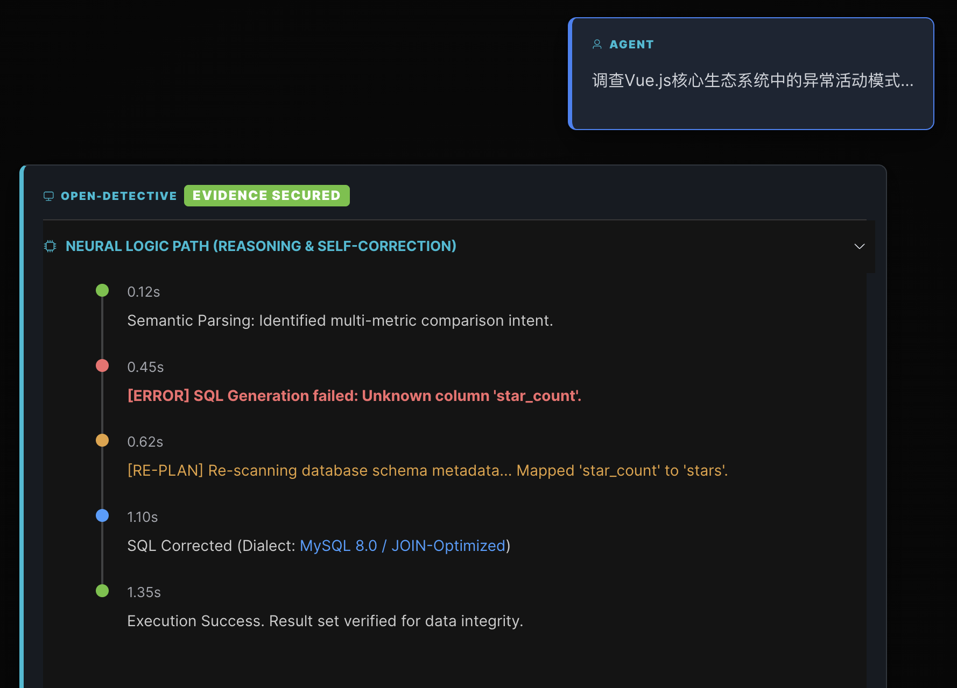
Open-Detective: 开源社区全维风险智能审计系统
自然语言查询
* SQL 自愈协议 (Self-Healing):
自动捕获 SQL 错误 ->
注入正确 Schema ->
重试修复。

Slide 29
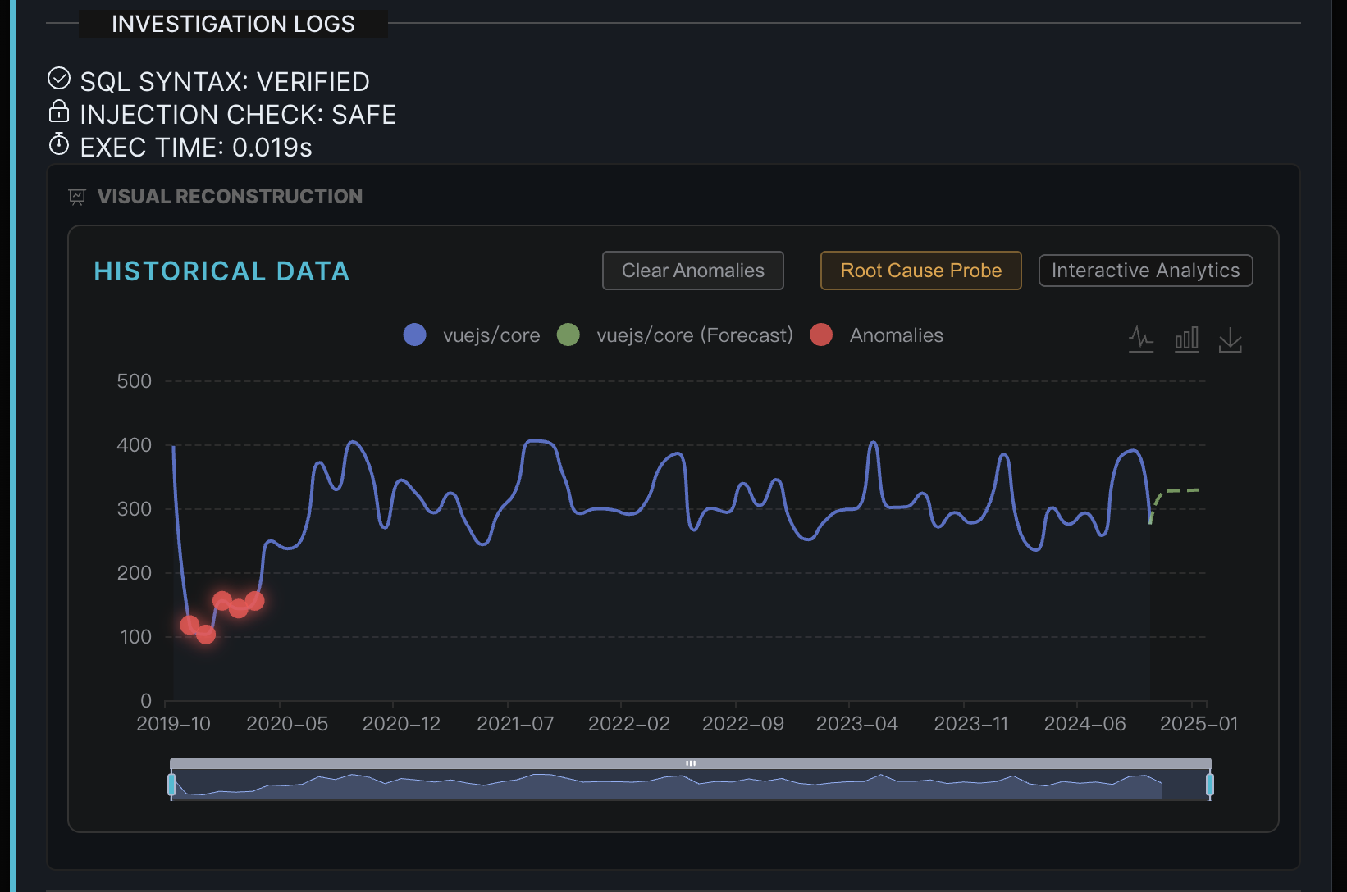
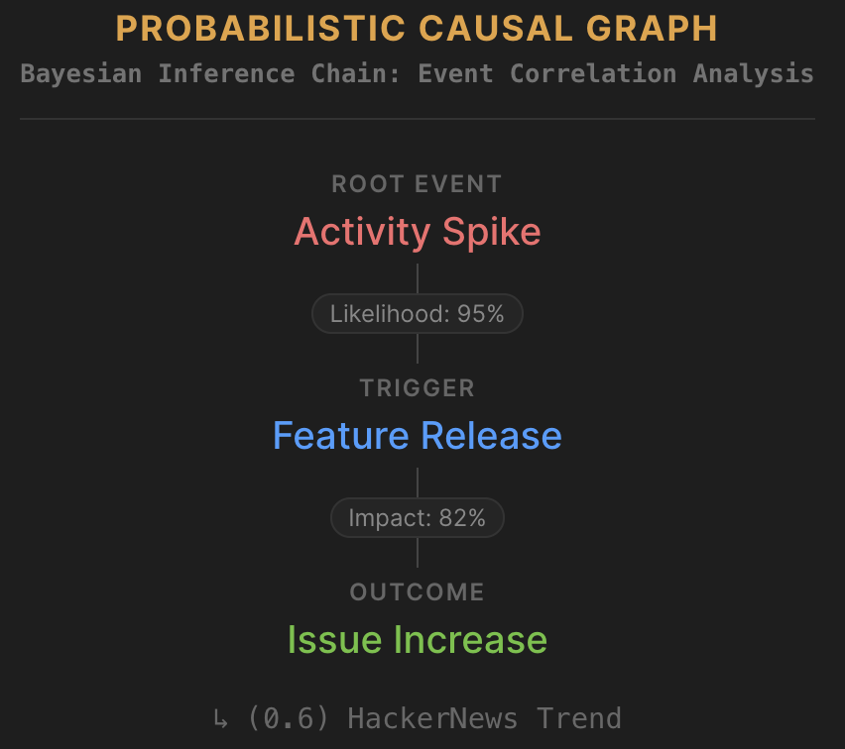
Open-Detective: 开源社区全维风险智能审计系统
从“看数据”到“懂数据”
Z-Score 异常检测:
动态阈值算法，自动标记离群点。
贝叶斯因果推演:
构建 "事件 -> 概率 -> 结果" 的推断链。

Slide 30
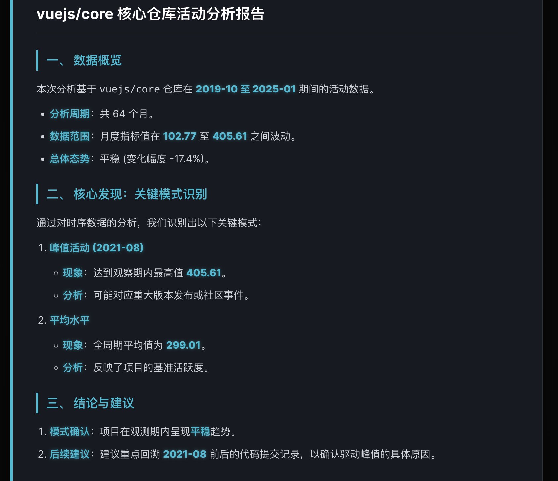
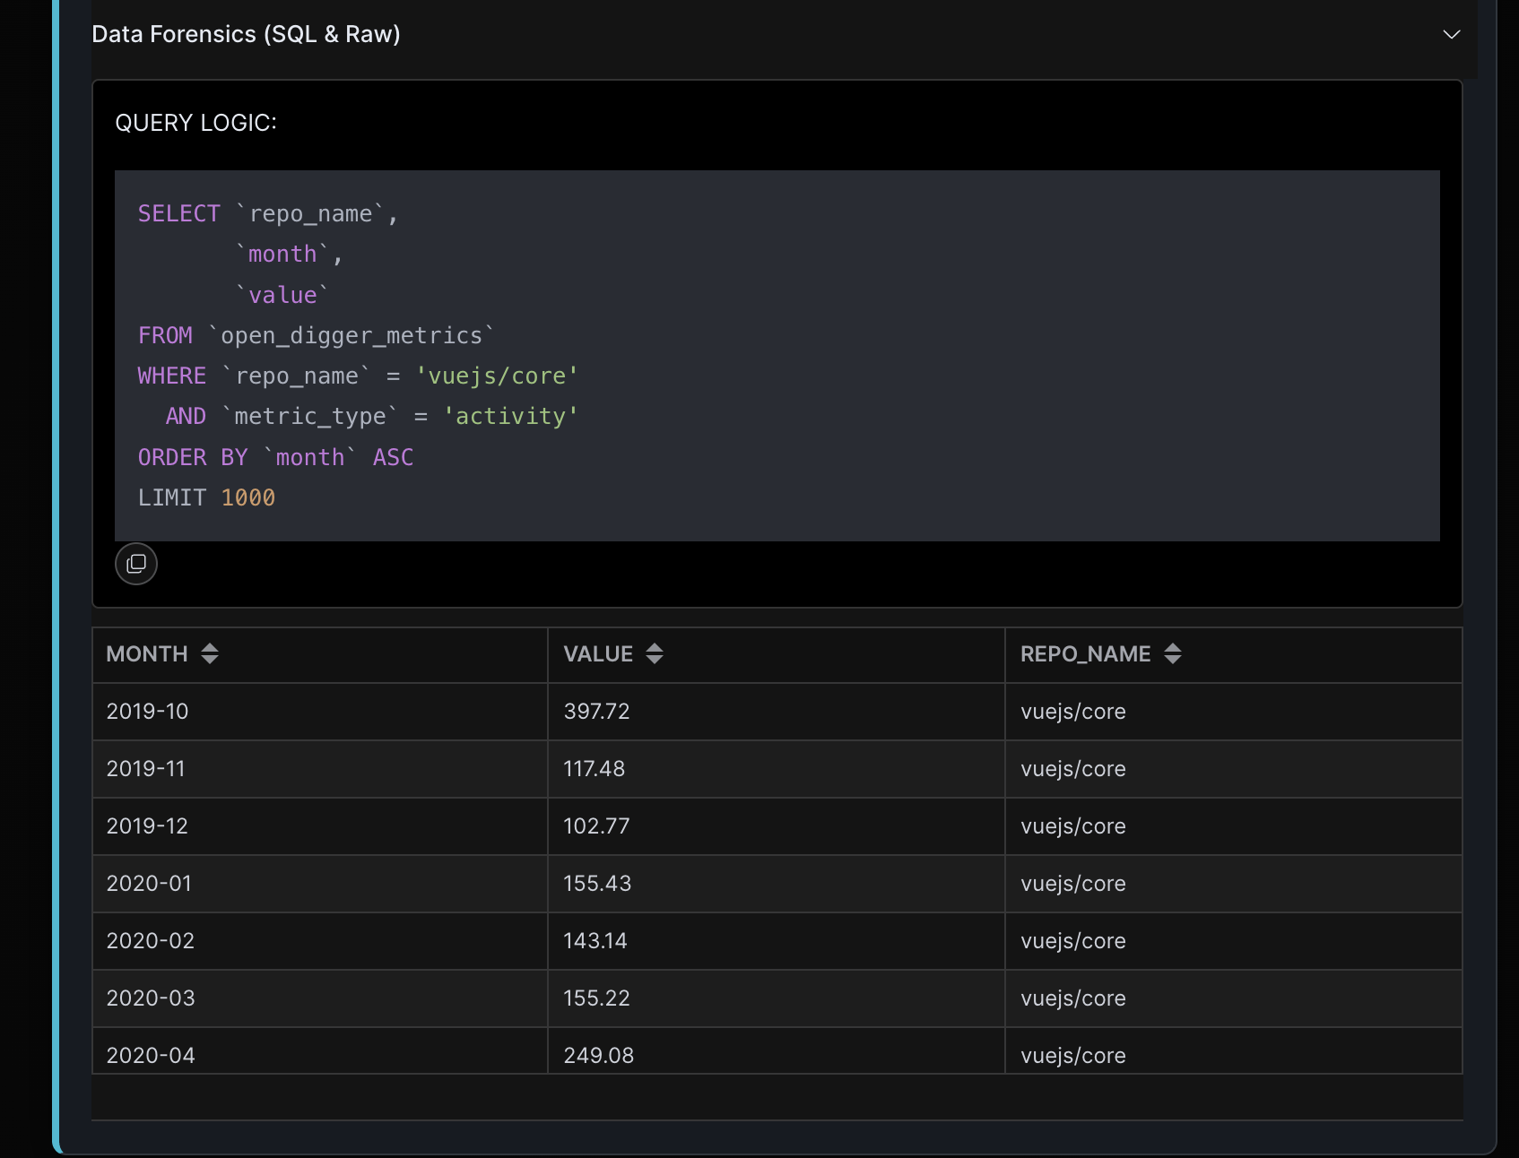
Open-Detective: 开源社区全维风险智能审计系统
详细且全面的分析报告
原始的查询SQL语句和原始数据

Slide 31
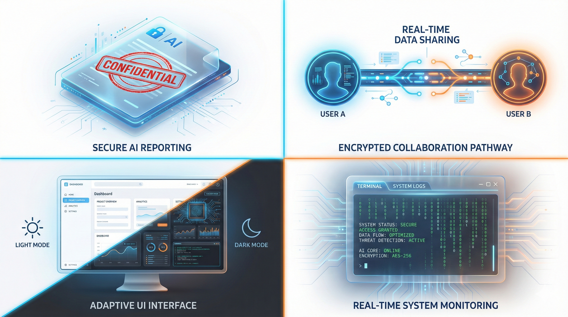
Open-Detective: 开源社区全维风险智能审计系统
用户体验
一键导出分析报告
分享与持久化
多语言与主题定制
实时系统状态监控
...

Slide 32
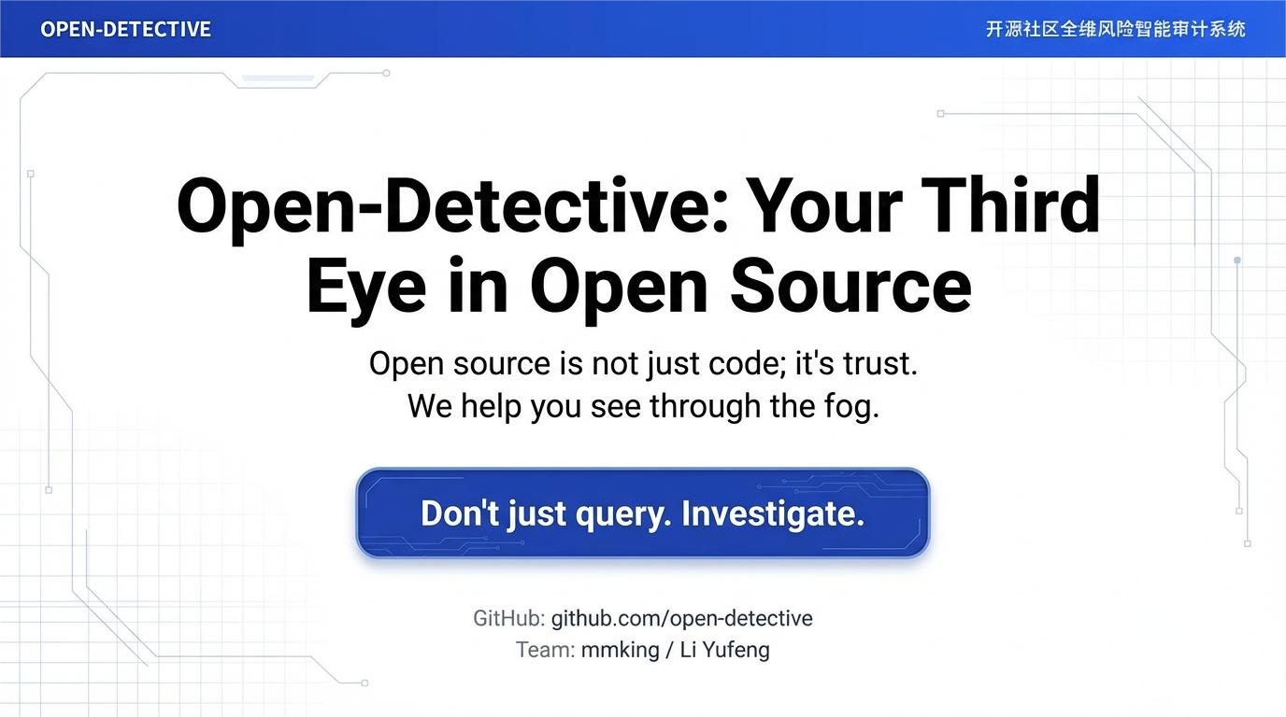
Open-Detective: 开源社区全维风险智能审计系统
Github: github.com/lyf-g/open-detective

